Slide 1

Accountants Growth Academy
Bristol – 19th March 2026

Slide 2
Humanise the Numbers
Challenge – Connect – Transform
Improve

Slide 3
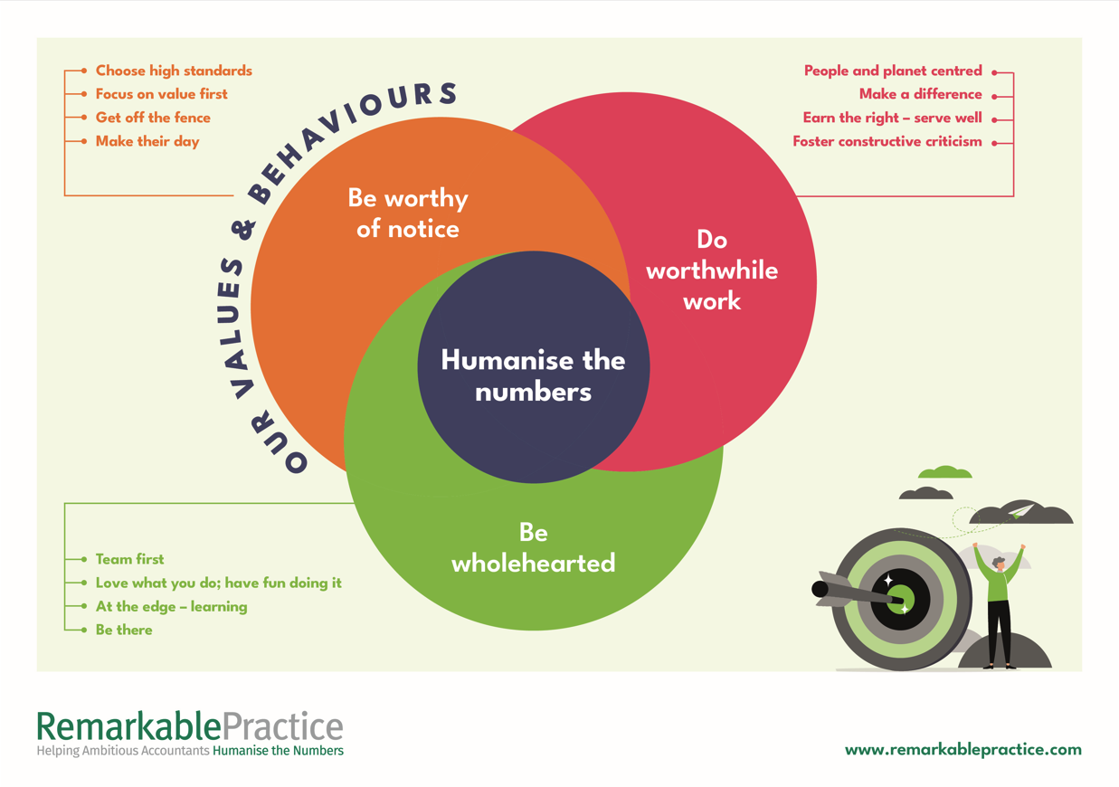
Be professional
Treat others as you would like
Be accountable for your actions
Be organised
Be conscientious
To be the best you can be
Notes:
Every day!!!!!
Top 10 music videos have been watched over 10 billion times – for free – exact and free – exact and cheap

Slide 5
Today’s agenda
09.30 – 10.45 Accountability session – peer accountability
11.00 – 12.45 Why a culture of self-accountability?
13.30 – 14.45 Creating a culture of self-accountability
15.00 – 16.15 Action planning and next steps forms

Slide 6
Accountability session

Slide 7
Accountability session
Buddy up with a peer
Discuss your commitments
Agree what has been fulfilled, and what hasn’t
Discuss & understand reasons why
Be ready to report back on your peer’s behalf

Slide 8
Accountability session
Peer groups…
RS Partnership and Anthony Russel
Russell & Russell and Pinfields
Moneypad and Paul Shrimpling
Pulse and PG Owen
Myers Clark and Loucas

Slide 9
Accountability session
Buddy up with a peer
Discuss your commitments
Agree what has been fulfilled, and what hasn’t
Discuss & understand reasons why
Be ready to report back on your peer’s behalf

Slide 10
When reporting back…
Be succinct – 2 mins for each firm
Focus on learning points
What will they do differently next time?
Be succinct – 2 mins for each firm

Slide 11
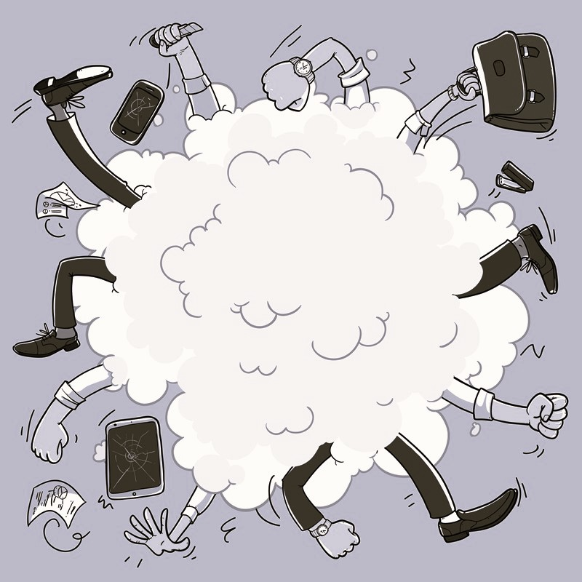
Assion

Slide 12
Accountability session
Observations?

Slide 13
BREAK

Slide 14
Accountability
…an obligation or willingness to accept responsibility, or to account for one’s actions…

Slide 15
Self-Accountability
…an obligation or willingness to accept responsibility, or to account for one’s actions…

Slide 16
Self-Accountability
EXERCISE: What happens when there is no culture of accountability? What is the impact on…
1. Your team
2. Your managers
3. Your clients
4. Your firm
Quantify the financial impact on all these stakeholders

Slide 17
“You are not your grand plans.
You are your daily patterns”
- James Clear

Slide 18
▲ ABOVE
▼ BELOW
OAR BED
Above the line peak mindset
Building high-performing teams through ownership, accountability & responsibility
Kiyosaki · DePorter · Thurber

Slide 19
THE CORE IDEA
ONE CHOICE
SHARED LANGUAGE
Every person, every moment
Is above or below the line
And they get to choose
A common team vocabulary
Names behaviour, not people
Simple, powerful, memorable
2 / 6

Slide 20
▲ ABOVE THE LINE · OAR
Victor · Pro-active · Solution focused
O
Ownership
A
Accountability
R
Responsibility
"I see it"
"I own it"
"I do it"
I notice what needs doing
I act without being told
I take the initiative
I own the outcome fully
I don't shift blame
I honour my commitments
I take deliberate action
I listen and stay curious
I choose response, not reaction
3 / 6

Slide 21
Sustainable
success
Client
Loyalty
Team Engagement
Manager
Skills & Mindset
HOW TO TRANSFORM YOUR FIRM’S RESULTS

Slide 22
▼ BELOW THE LINE · BED
Victim · Reactive · Problem focused
B
Blame
E
Excuse
D
Denial
"Not my fault"
"Not my job"
"No need to learn"
I point fingers at others
I focus on who caused it
I ignore my own part
I explain why it can't happen
I focus on obstacles
I wait for someone else
I ignore the real problem
I resist honest feedback
I hope it goes away
4 / 6

Slide 23
THE MANAGER'S JOB
Lead by example
Name it openly
Model OAR in your language
Your choices set the culture
Silence on BED endorses it
Use OAR / BED as team shorthand
Removes personal sting
Makes behaviour, not people, visible
Coach — don't rescue
Address BED early
Rescuing keeps people in BED
Ask questions, don't give answers
Build capacity, not dependence
Blame left unchecked spreads
One person lowers the bar
Early conversation beats late crisis
5 / 6

Slide 24
THE DEEPER SHIFT
▲
Performance rises above the line
safety + ownership = cognitive peak
◈
The line exists whether visible or not
Making it visible gives people agency
▼
Victimhood isn't a personality type
It's a habit — and habits can change
STAY OUT OF BED · PICK UP YOUR OAR
6 / 6

Slide 25
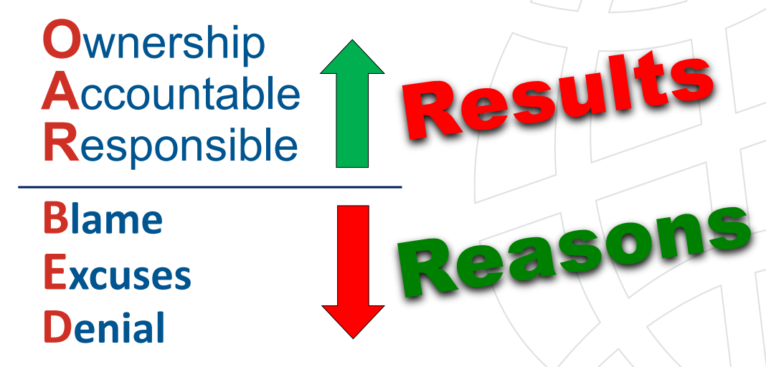
Accountability
Exercise: What do you find challenging/difficult about accountability conversations?

Slide 26
Self-accountability
Exercise: Leadership Accountability checklist
How is your culture of accountability right now?

Slide 27
Self-accountability
Answer the questions as honestly as you can so you know your benchmark

Slide 28
Self-accountability
Why is a culture of accountability important?

Slide 29
Sustainable
success
Client
Loyalty
Team Engagement
Manager
Skills & Mindset
HOW TO TRANSFORM YOUR FIRM’S RESULTS

Slide 30





Accountability – some role models

Slide 31


Slide 32
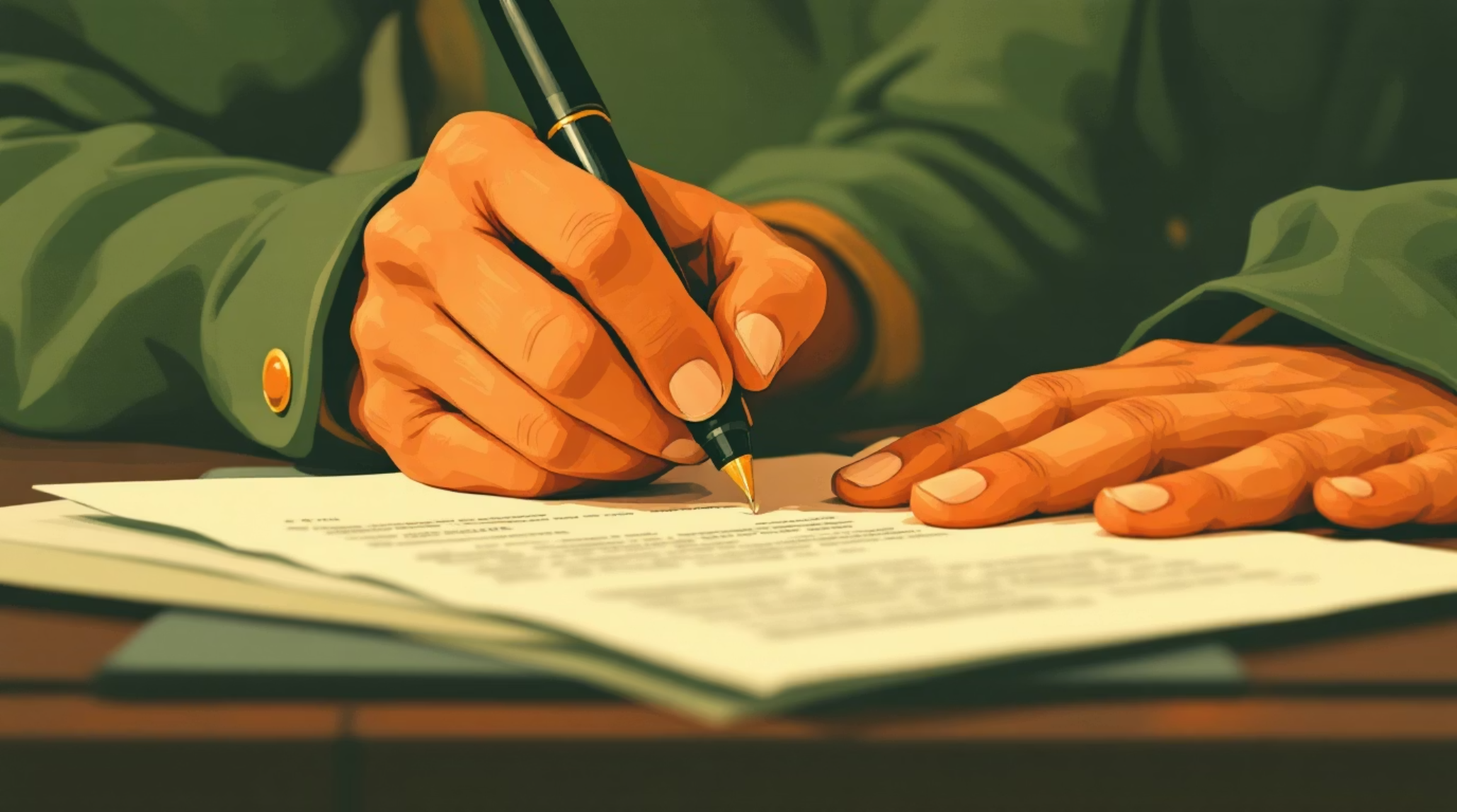
The "Maniac Pledge": Nurturing Accountability
TRIBAL CULTURE
A cornerstone of WD-40's tribal culture and commitment to lifelong learning, the Maniac Pledge is more than a formality — it is a declaration.
Every tribe member signs it.
Every tribe member lives it.

Slide 33
TRIBAL CULTURE
The "Maniac Pledge": Nurturing Accountability
Ownership
Every employee takes personal accountability for outcomes.

Slide 34
TRIBAL CULTURE
The "Maniac Pledge": Nurturing Accountability
Learning
Continuous growth is not optional — it's a shared obligation.

Slide 35
TRIBAL CULTURE
The "Maniac Pledge": Nurturing Accountability
Communication
Transparency flows in all directions — asking and telling are equally vital.

Slide 36
The Maniac Pledge
"I am responsible for taking action, asking questions, getting answers, and making decisions. I won't wait for someone to tell me. If I need to know, I'm responsible for asking. I have no right to be offended that I didn't 'get this sooner.' If I'm doing something others should know about, I'm responsible for telling them."
— Signed by every WD-40 tribe member worldwide

Slide 37
The Maniac Pledge
"I am responsible for taking action, asking questions, getting answers, and making decisions”.
— Signed by every WD-40 tribe member worldwide

Slide 38
The Maniac Pledge
"I am responsible for taking action, asking questions, getting answers, and making decisions. I won't wait for someone to tell me”.
— Signed by every WD-40 tribe member worldwide

Slide 39
The Maniac Pledge
"I am responsible for taking action, asking questions, getting answers, and making decisions. I won't wait for someone to tell me. If I need to know, I'm responsible for asking."
— Signed by every WD-40 tribe member worldwide

Slide 40
The Maniac Pledge
"I am responsible for taking action, asking questions, getting answers, and making decisions. I won't wait for someone to tell me. If I need to know, I'm responsible for asking. I have no right to be offended that I didn't 'get this sooner.'
— Signed by every WD-40 tribe member worldwide

Slide 41
The Maniac Pledge
"I am responsible for taking action, asking questions, getting answers, and making decisions. I won't wait for someone to tell me. If I need to know, I'm responsible for asking. I have no right to be offended that I didn't 'get this sooner.' If I'm doing something others should know about, I'm responsible for telling them."
— Signed by every WD-40 tribe member worldwide

Slide 42
The Maniac Pledge
"I am responsible for taking action, asking questions, getting answers, and making decisions. I won't wait for someone to tell me. If I need to know, I'm responsible for asking. I have no right to be offended that I didn't 'get this sooner.' If I'm doing something others should know about, I'm responsible for telling them."
— Signed by every WD-40 tribe member worldwide

Slide 43

LEARNING CULTURE
Why "Maniac"?
Learning Maniacs
Being a "maniac" means an unrelenting hunger for learning, sharing knowledge, and growing every single day — not just when it's convenient.

Slide 44

LEARNING CULTURE
Why "Maniac"?
Decentralised accountability
Responsibility for growth and learning doesn't sit with management alone — it belongs to every individual in the tribe.

Slide 45

LEARNING CULTURE
Why "Maniac"?
Learning moments, not failures
The Pledge reframes failure as a learning moment, creating psychological safety that fuels innovation and deeper engagement.

Slide 46
The Impact of Our Culture
RESULTS
3x
Value Growth
Company value nearly tripled since 2009, driven by global expansion and new brands.
A culture of ownership and accountability — built from the top,
embraced by everyone.

Slide 47
The Impact of Our Culture
RESULTS
90%+
Employee engagement
Consistently above 90% — well beyond the global average of most organizations.
A culture of ownership and accountability — built from the top,
embraced by everyone.

Slide 48
The Impact of Our Culture
RESULTS
98%
Proud to belong
98% of employees love telling others they work at WD-40. That's culture you can measure.
A culture of ownership and accountability — built from the top,
embraced by everyone.

Slide 49
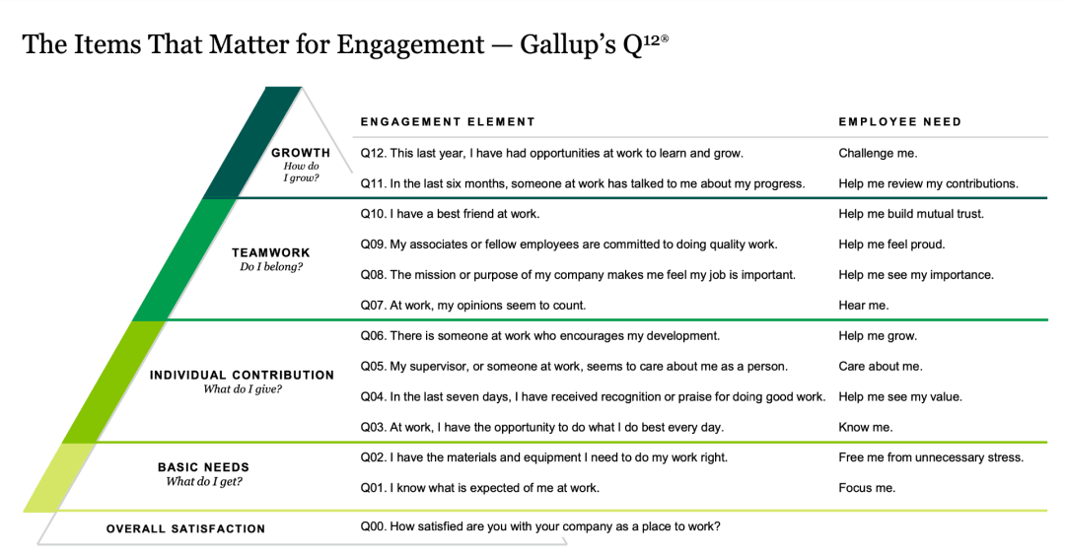
Accountability

Slide 50
Self-accountability
Exercise: Gallup Q12 survey – how might WD-40 employees score each question?

Slide 51
The Maniac Pledge
"I am responsible for taking action, asking questions, getting answers, and making decisions. I won't wait for someone to tell me. If I need to know, I'm responsible for asking. I have no right to be offended that I didn't 'get this sooner.' If I'm doing something others should know about, I'm responsible for telling them."
— Signed by every WD-40 tribe member worldwide

Slide 52
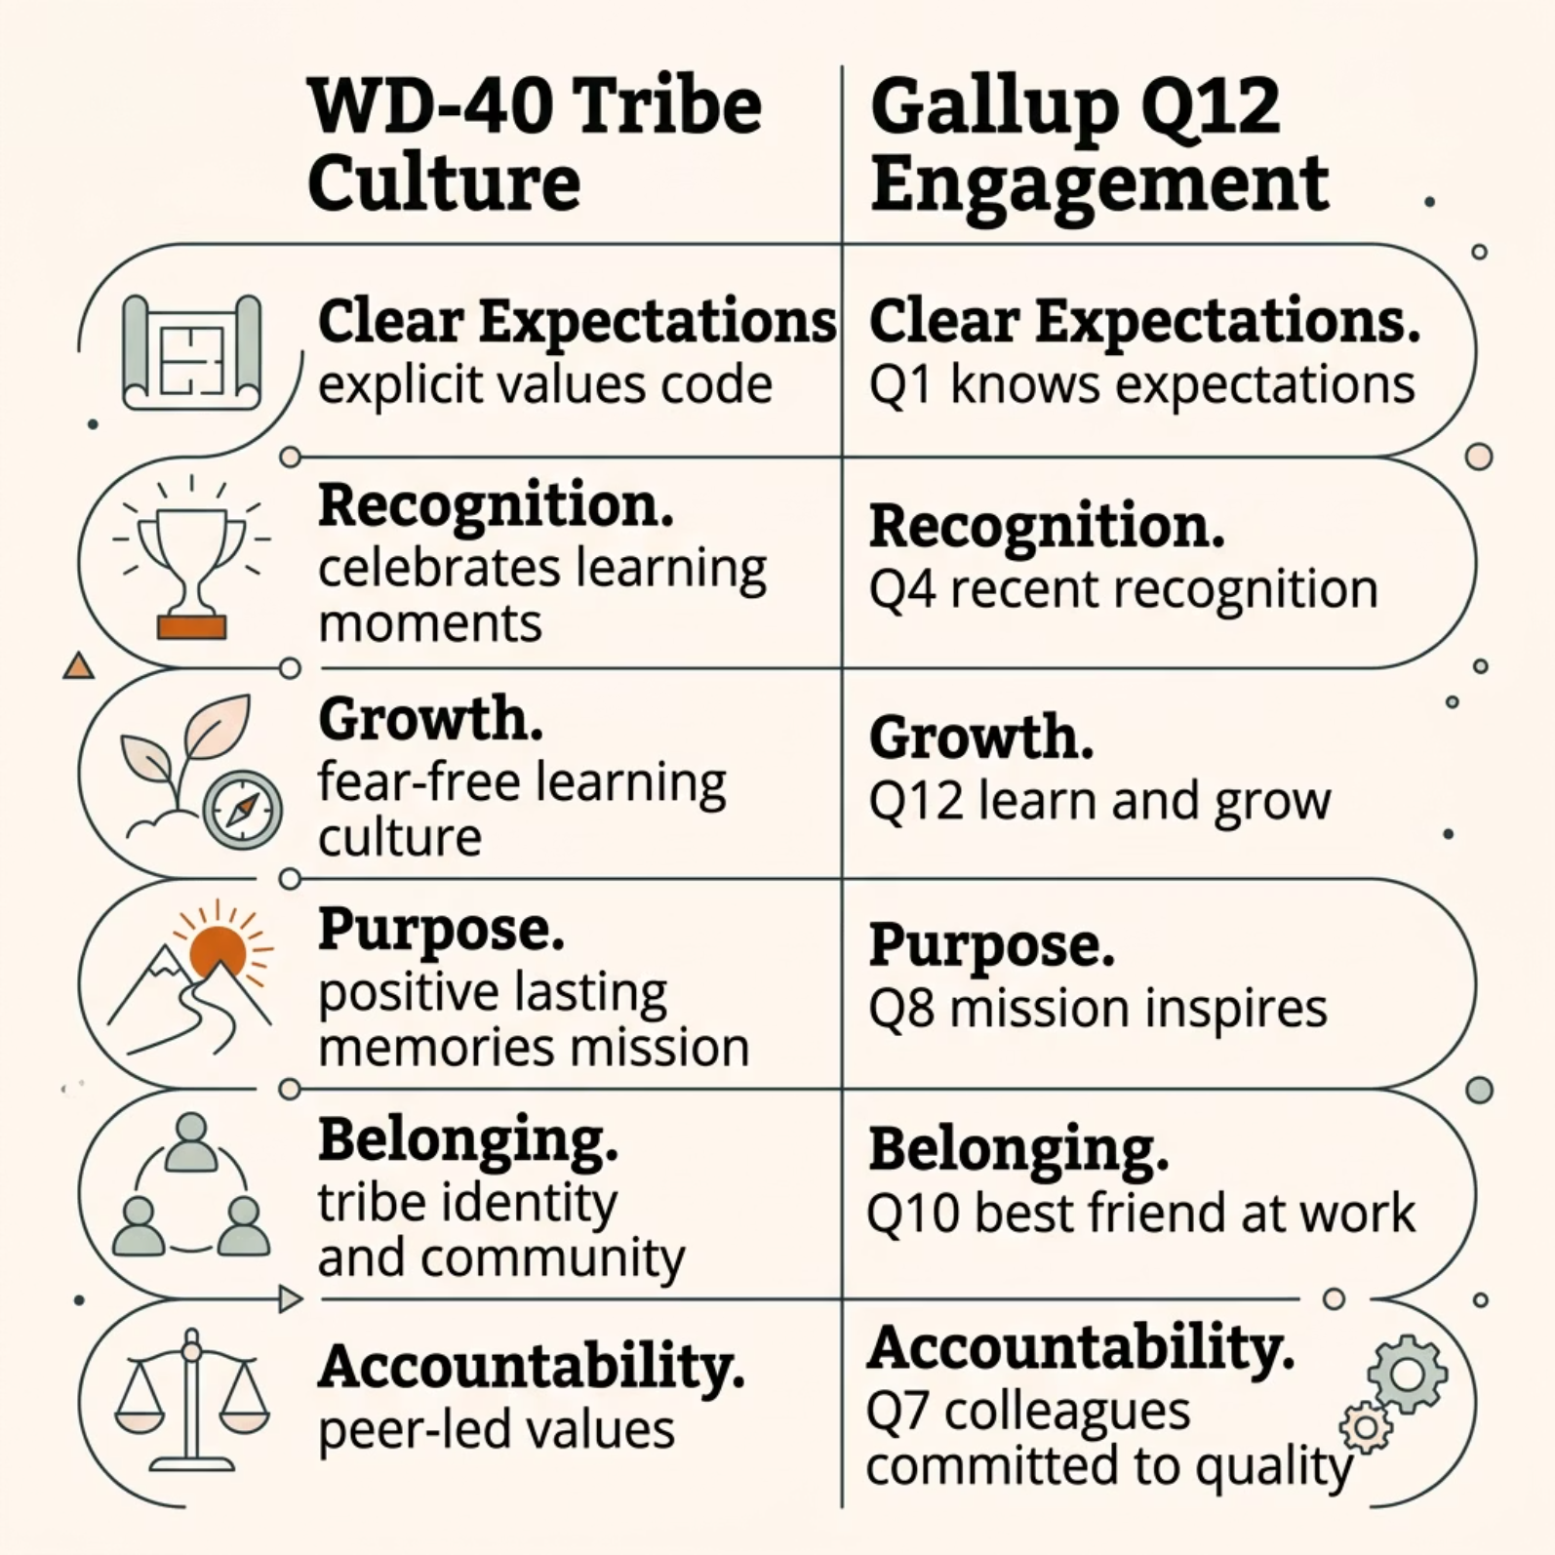

Side-by-Side Comparison

Slide 53
Side-by-Side Comparison

Slide 54
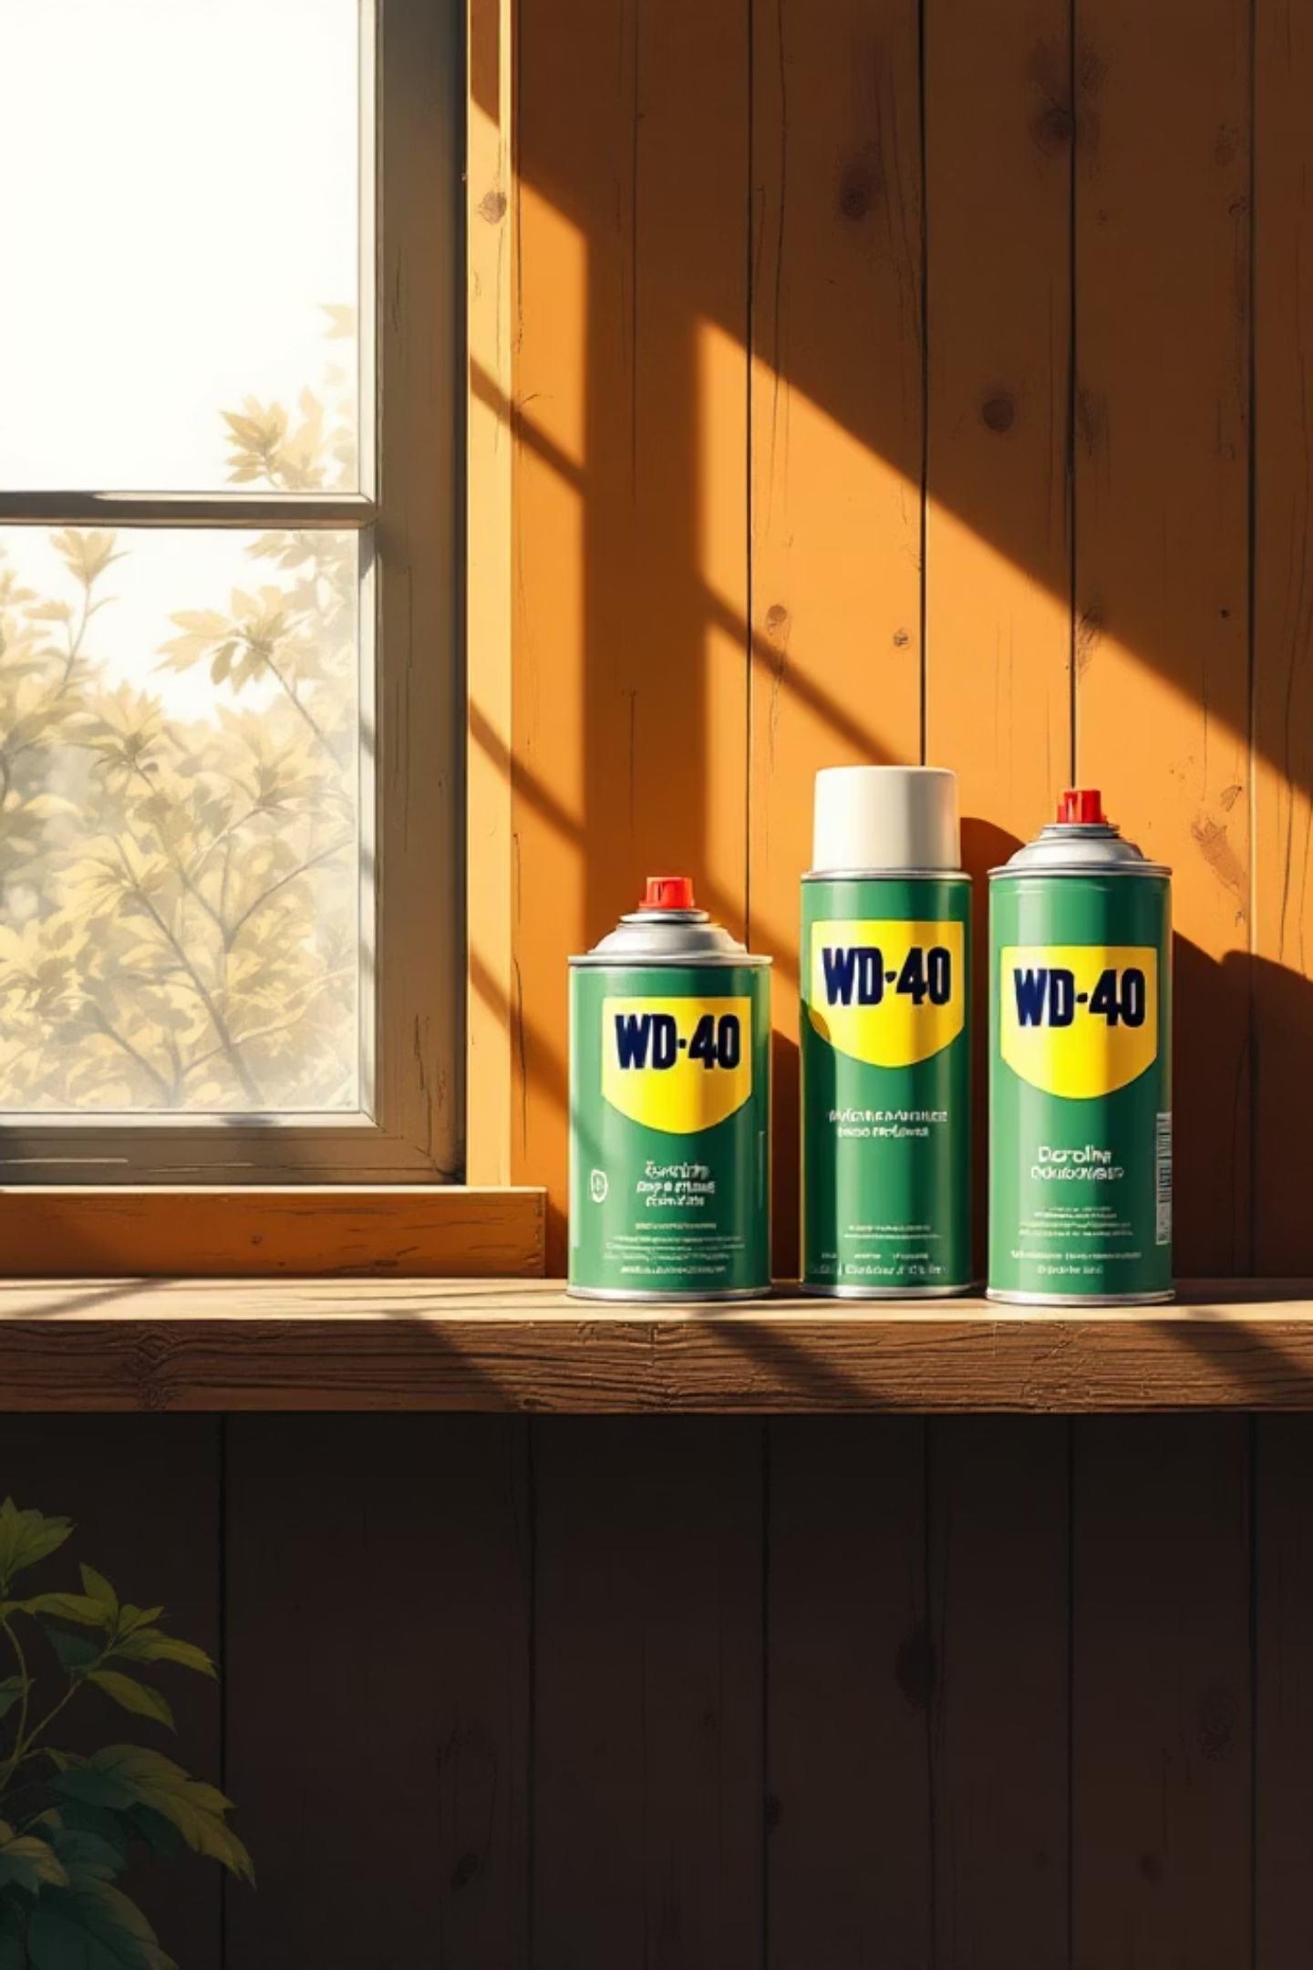
Key Takeaway
WD-40 doesn't just score well on engagement surveys — it has built a culture that makes the Q12 questions feel like natural outcomes, not targets to chase.
93–98%
Q12 Aligned
Engagement scores sustained year after year
Covers all 12 Gallup drivers organically
Culture First
Values and belonging precede performance

Slide 55
Accountability

Slide 56
BREAK

Slide 57
QFOCUS — PERSONAL
I do what I say I’ll do. When I don’t, I own it – no excuses, no finger-pointing, no going quiet.
What questions does this raise for you?

Slide 58
QFOCUS — MY TEAM
My team does what they say they’ll do. When they don’t, they own it –
no excuses, no finger-pointing,
no going quiet.
What questions does this raise for you?

Slide 59
Self-accountability
Exercise: What are your best three questions based on this statement?

Slide 60
Self-accountability
How to: Building a culture of self-accountability

Slide 61

Start with Clear Expectations and Roles
The foundation of any high-performing team begins with clarity — ensuring every individual understands what is expected of them and the role they play within the wider organisation.

Slide 62
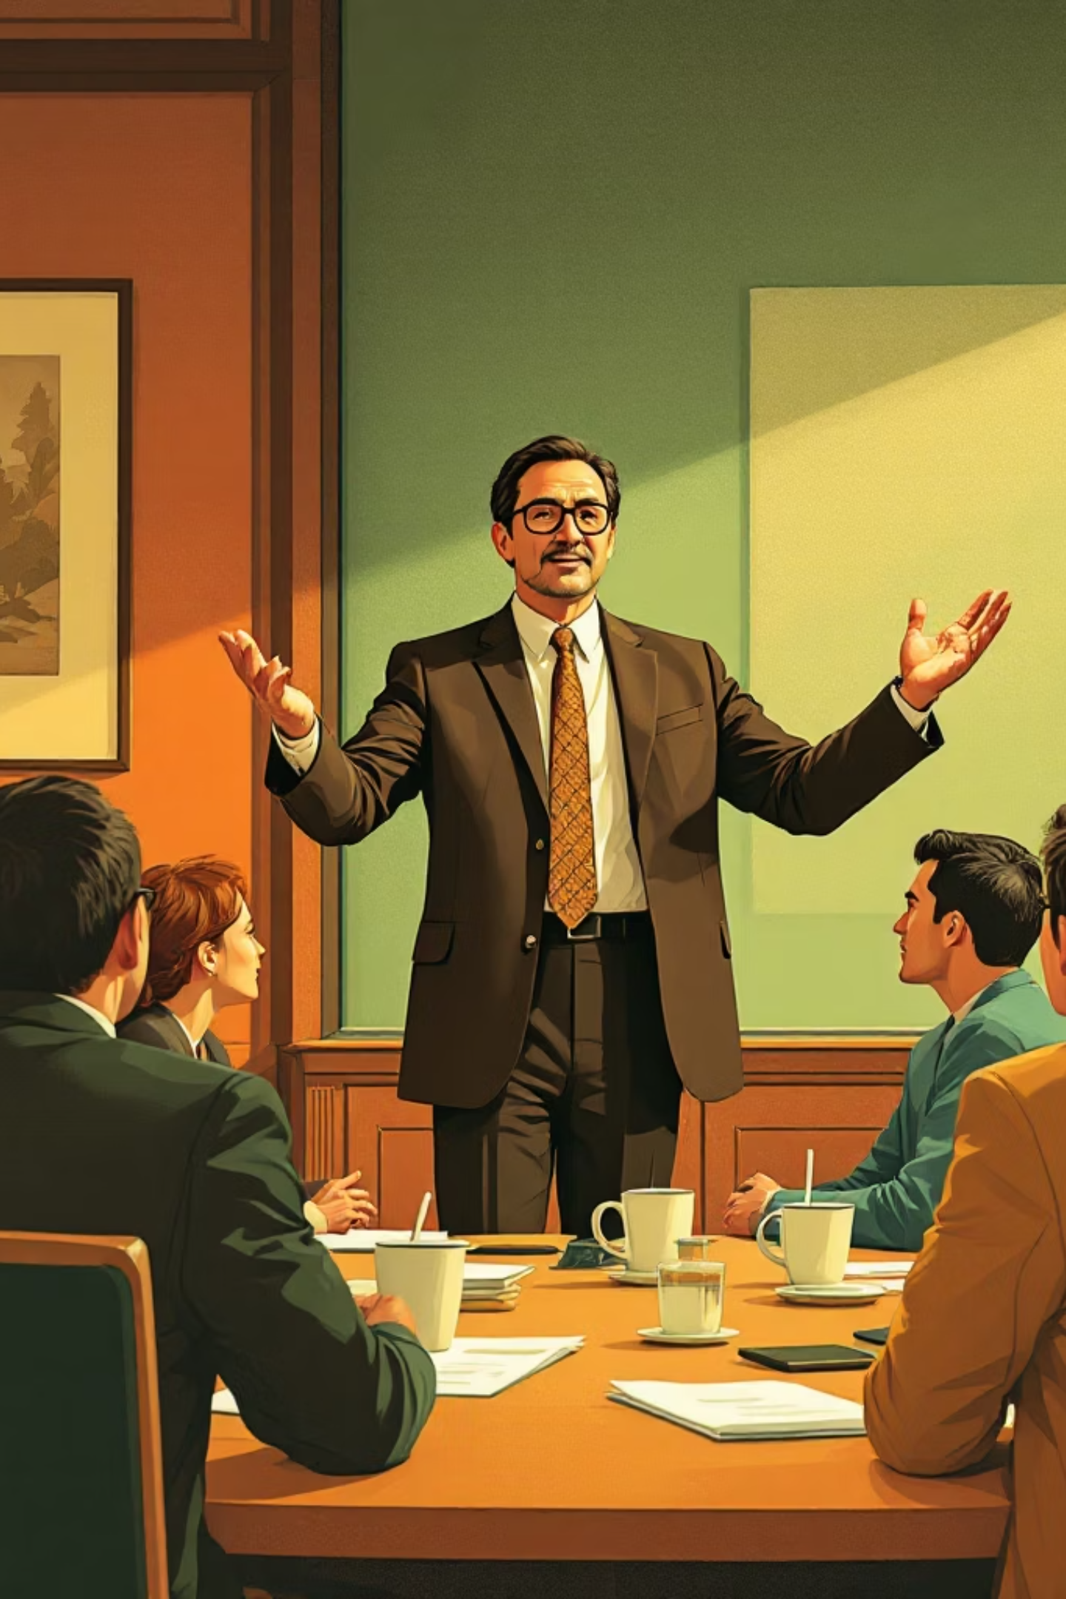
Building a Culture of Openness
Lead by Example
Demonstrate the behaviours and standards you expect from your team. When leaders model accountability, integrity, and commitment, it sets a powerful precedent for everyone around them. Be vulnerable!
Communicate Openly
Create an environment where honest, transparent communication is the norm. Share information freely, encourage questions, and ensure every voice is heard and valued across all levels of the team.

Slide 63
Reinforcing Accountability
Provide Regular Feedback
Recognise and Reward Accountability
Consistent, constructive feedback helps individuals understand how they are performing against expectations. Regular check-ins and honest conversations enable continuous improvement and keep everyone aligned with team goals.
Acknowledge and celebrate those who take ownership of their responsibilities. Recognising accountable behaviour — whether through formal rewards or simple praise — reinforces the values you want to embed across your team culture.

Slide 64


Investing in Growth and Measurement
Offer Training and Development
Use Performance Metrics
Equip your team with the skills and knowledge they need to meet expectations and grow in their roles. Investing in development signals that you believe in their potential and are committed to their long-term success.
Establish clear, measurable indicators of success so that progress can be tracked objectively. Performance metrics provide a shared language for evaluating outcomes and identifying areas where additional support may be needed.

Slide 65

Sustaining Accountability Long-Term
Follow Through on Consequences
Accountability only holds meaning when there are real consequences — both positive and corrective. Following through consistently and fairly demonstrates that expectations are serious and that all team members are held to the same standard.
Foster Psychological Safety
Create a space where people feel safe to speak up, admit mistakes, and take calculated risks without fear of blame or ridicule. Psychological safety is the bedrock of a truly accountable culture — one where learning and growth can flourish.

Slide 66
Self-accountability
Start with clear expectations & roles:
Clearly define responsibilities for each role
Write down expectations and confirm mutual understanding
Define what success looks like
Great leaders remove any ambiguity by being crystal clear on expectations for every role in the business.

Slide 67
Self-accountability
Lead by example:
Admit mistakes quickly, share what you’ll do differently, and follow through – be vulnerable!
Be on time, meet your commitments, and avoid blaming others when things go wrong
Ask for feedback on your own performance to signal that accountability applies to everyone
When leaders behave this way, trust increases and people are more willing to hold themselves and others accountable. Culture flows downwards!

Slide 68
Self-accountability
Communicate openly:
Create an environment where people can contribute freely
Regular, honest communication becomes the norm
Build appropriate rhythm and cadence to communication
When leaders communicate openly, and it’s genuine two-way communication, trust increases and people are more willing to speak up

Slide 69
Self-accountability
Provide regular feedback:
Provide regular, timely and constructive feedback to reinforce accountability
Avoid blame, other than to blame the system – this encourages people to be more open and honest about what hasn’t gone right
Consistency embeds strong habits
When leaders provide regular feedback, the team can see a consistency and fairness of approach that avoids blame and seeks to improve systems for the benefit of clients and team.

Slide 70
Self-accountability
Recognise and reward accountability:
When someone owns a mistake, fixes a problem or delivers on a hard commitment, acknowledge it visibly
Make sure you have the forums/opportunities to be able to celebrate wins
Link accountability to hiring and firing decisions. You want people in your team who are unafraid of accountability
What gets celebrated gets repeated, so celebrate the behaviours behind great accountability, not just the results.

Slide 71
Self-accountability
Offer training and development:
Equip team members with the skills and knowledge to do their jobs properly
Check in regularly to support and ensure team members have all they need to succeed
Let people see where they’re headed so they feel part of the vision of the business
Great leaders consistently offer training and development so that growth becomes a regular habit.

Slide 72
Self-accountability
Use performance metrics:
Agree SMART goals or KPIs that are aligned to the wider organization’s vision – relevant information must be shared
Ensure goals are fair, clear and transparent
Ensure goals/KPIs are agreed by the team
Great leaders share relevant information to their teams to allow them to set their own goals.

Slide 73
Self-accountability
Follow through on consequences:
Build habits of checking in on commitments so your team sees consistency
Follow-through allows two-way accountability – the team can offer feedback on what you have delivered
Follow-through invites discussion around areas for improvement as well as areas of success
Great leaders are hugely consistent in their approach, letting people see that accountability is real and here to stay.

Slide 74
Self-accountability
Foster psychological safety:
Shifting from blame to taking responsibility encourages honesty
Inviting feedback from those doing the job tells people they’re important and their opinion is valued
Admit and own your mistakes and turn them into learning moments – what did we learn and how can we avoid it happening again?
Great leaders build an environment where it’s safe to speak up without fear of reprisal. Such an environment speeds up business.

Slide 75
BREAK

Slide 76
Self-accountability – action planning
What’s next for you?

Slide 77
“You are not your grand plans.
You are your daily patterns”
James Clear

Slide 78
Self-accountability – action planning
What’s next for you?
Old habits…NEVER DIE!
What new habits will YOU create to improve your daily patterns?

Slide 79
Self-accountability – action planning
What’s next for your firm?
Old habits…NEVER DIE!
What new habits will you create to improve the daily and weekly routines in your firm to create a culture of accountability?

Slide 80
Self-accountability – action planning
Next steps forms
Commit to a SMART goal
What KPIs will tell you that you’re on track to achieving your SMART goal?
Consider what might get in the way
What are the committed, diarised next steps?

Slide 81
Accountants Growth Academy
What’s been of most value to YOU personally as a consequence of being here today?

Slide 82
Accountants Growth Academy
Thank you!

Slide 83
Accountability
Exercise: What do you find challenging/difficult about accountability conversations?

Slide 84
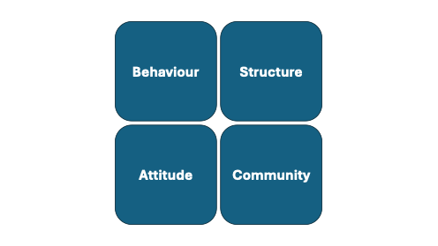

Slide 85
Team
engagement
Client
loyalty
Firm
success
Notes:
Cause they decide whether they stay pay and say

Slide 86
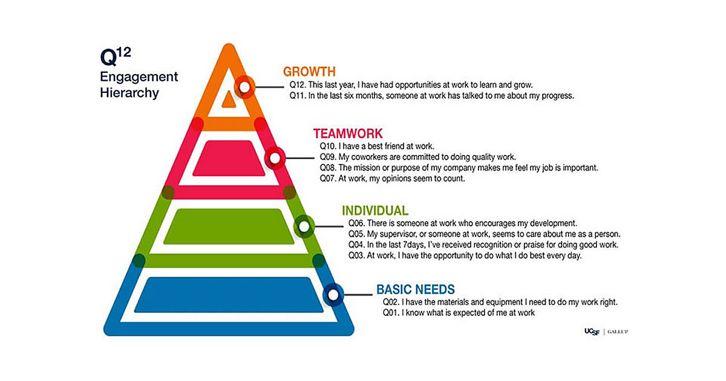
Team
engagement
Client
loyalty
Firm
success
Notes:
Cause they decide whether they stay pay and say

Slide 87
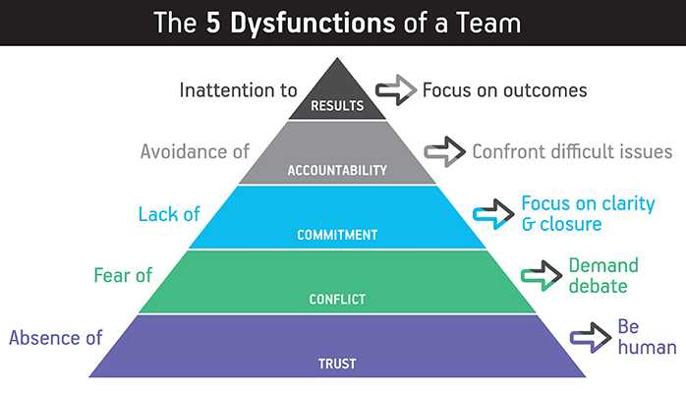
Accountability

Slide 88
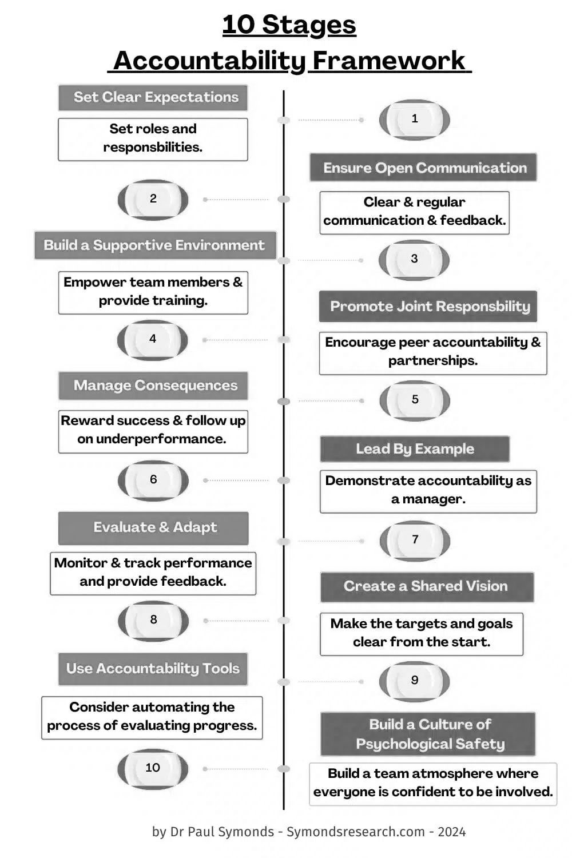
Accountability

Slide 89
Team
engagement
Client
loyalty
Firm
success
Notes:
Cause they decide whether they stay pay and say

Slide 90
If you want to strengthen your leadership, try this small daily practice.
Once a day, choose one person–a colleague, a direct report, someone you work alongside—and ask a real question. not the autopilot "How's it going? that everyone answer with "Fine."
Instead, try something more genuine:
"How are you, really?"
"What's one thing making your job harder than it needs to be?"
"What would good look like from here?"
Then, give them 90 seconds of your full attention. No phone, no interruptions, and no rushing to solve the problem right away... Simply listen.
Moments like this may seem small, but they build trust, surface challenges earlier, and help people feel seen and valued. Over time, those moments compound into something larger—a culture where people feel safe to speak up and contribute their best work.

Slide 91
Sustainable
success
Client
Loyalty
Team Engagement
HOW TO TRANSFORM YOUR FIRM’S RESULTS

Slide 92
Sustainable
success
Client
Loyalty
Team Engagement
Manager
Skills & Mindset
HOW TO TRANSFORM YOUR FIRM’S RESULTS

Slide 93
Sustainable
success
Client
Loyalty
Team Engagement
Manager
Skills & Mindset
HOW TO TRANSFORM YOUR FIRM’S RESULTS
DCC score
Q12 score
Client loyalty score
Results

Slide 94
Accountability
Question: On the basis of these triggers, what could best describe your frame of mind going into an accountability conversation?

Slide 95
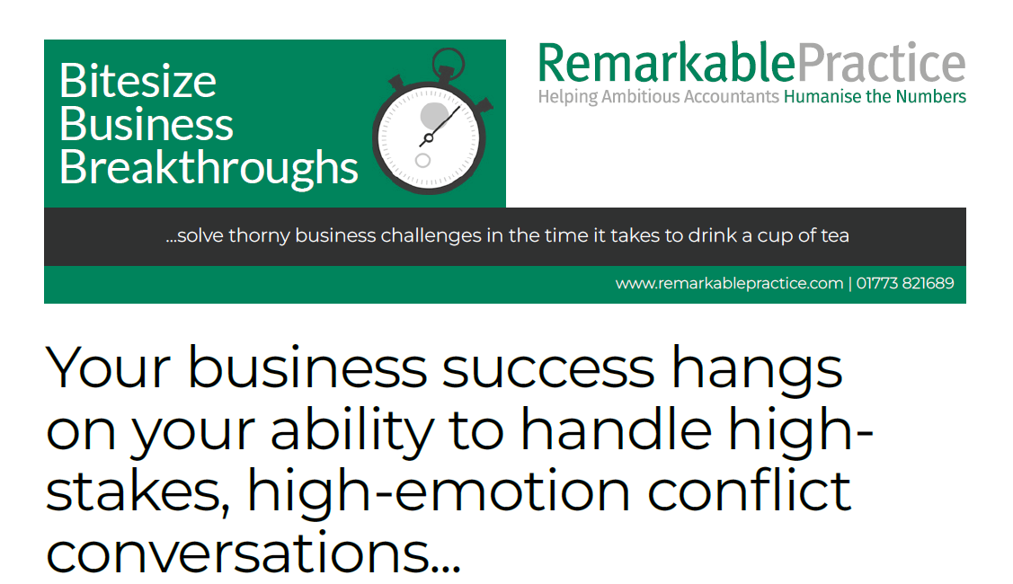
Accountability

Slide 96
Accountability
1. Success stories – what’s gone well?
2. What’s not gone so well?
3. Which frameworks would you want us to go over?
4. What conversations do you need to have?
5. AOB?

